Slide 1
UNIT-II

Slide 2
UNIT - II: SOLAR PHOTOVOLTAIC SYSTEMS
Solar photovoltaic cell, module, array – construction – Efficiency of solar cells – Developing technologies – Cell I-V characteristics – Equivalent circuit of solar cell – Series resistance – Shunt resistance – Applications and systems – Balance of system components - System Design: storage sizing – PV system sizing – Maximum power point techniques: Perturb and observe (P&O) technique – Incremental conduction Technique.

Slide 3
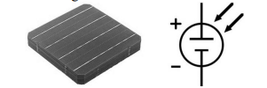
Solar Photovoltaic systems: Basic Principle of SPV conversion
A photovoltaic (PV) cell is an energy harvesting technology that converts solar energy into useful electricity (DC) through a process called the photovoltaic effect.
It is made up of semiconductor materials such as silicon, gallium arsenide and cadmium telluride, etc.
These cells vary in size ranging from about 0.5 inches to 4 inches.
There are different types of PV cells which all use semiconductors to interact with incoming photons from the Sun in order to generate an electric current.

Slide 4
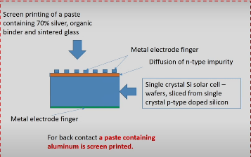
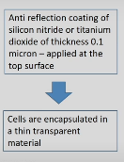

Construction

Slide 5
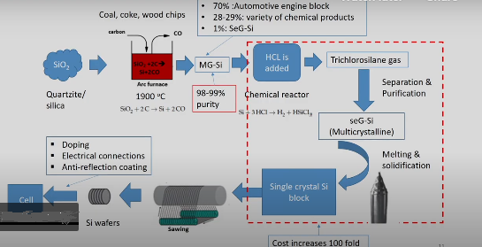
Production process

Slide 6
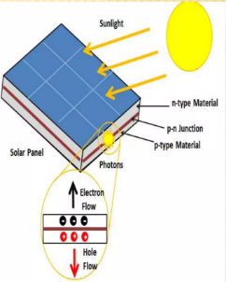
Photovoltaic cell concepts: Cell
A photovoltaic cell is comprised of many layers of materials, each with a specific purpose.
The most important layer of a photovoltaic cell is the specially treated semiconductor layer. It is comprised of two distinct layers of p-type and n-type, and is what actually converts the Sun's energy into useful electricity through a process called the photovoltaic effect.
On either side of the semiconductor is a layer of conducting material which "collects" the electricity produced.

Slide 7
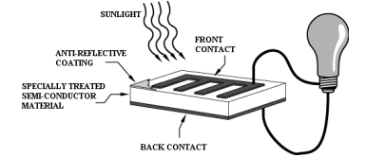
The final layer which is applied only to the illuminated side of the cell is the anti-reflection coating.
Since all semiconductors are naturally reflective, reflection loss can be significant.
The solution is to use one or several layers of an anti-reflection coating (similar to those used for eyeglasses and cameras) to reduce the amount of solar radiation that is reflected off the surface of the cell.

Slide 8
Photovoltaic Effect
The photovoltaic effect is a process that generates voltage or electric current in a photovoltaic cell when it is exposed to sunlight.
These solar cells are composed of two different types of semiconductors—a p-type and an n-type that are joined together to create a p-n junction.
By joining these two types of semiconductors, an electric field is formed in the region of the junction as electrons move to the positive p-side and holes move to the negative n-side.
This field causes negatively charged particles to move in one direction and positively charged particles in the other direction.

Slide 9
Light is composed of photons, which are simply small bundles of electromagnetic radiation or energy.
When light of a suitable wavelength is incident on these cells, energy from the photon is transferred to an electron of the semiconducting material, causing it to jump to a higher energy state known as the conduction band.
In their excited state in the conduction band, these electrons are free to move through the material, and it is this motion of the electron that creates an electric current in the cell.

Slide 10
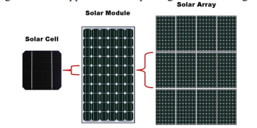
Cell: A photovoltaic cell is the most basic unit of a solar PV system - solar cells can be either monocrystalline or polycrystalline, and their key characteristic is that they produce a voltage output when exposed to light. Each cell produces approximately 1/2 a volt.
Module: A photovoltaic module consists of multiple PV cells connected in series to provide a higher voltage output. PV modules are manufactured in standard sizes. A solar module designed for charging a 12 volt battery will typically have 36 solar cells while the typical residential grid connected system uses solar modules with 60 solar cells. By increasing the number of solar cells the module voltage and wattage increases.
Array: A photovoltaic array is a system composed of multiple PV modules. They can be connected in one or more series circuits, which are connected to a combiner box to provide a single directcurrent output.

Slide 11
Applications.
• Residential Application: Use of solar energy for homes has number of advantages. The solar energy is used in residential homes for heating the water with the help of solar heater. The photovoltaic cell installed on the roof of the house collects the solar energy and is used to warm the water. Solar energy can also be used to generate electricity. Batteries store energy captured in day time and supply power throughout the day. The use of solar appliances is one of the best ways to cut the expenditure on energy.
• Industrial Application: Sun‘s thermal energy is used in office, warehouse and industry to supply power. Solar energy is used to power radio and TV stations. It is also used to supply power to lighthouse and warning light for aircraft.
• Remote Application: Solar energy can be used for power generation in remotely situated places like schools, homes, clinics and buildings. Water pumps run on solar energy in remote areas.

Slide 12
Transportation: Solar energy is also used for public transportation such as trolleys, buses and light rails.
• Pool heating: Solar heating system can be used to heat up water in pool during cold seasons
Solar Green Houses: A green house is a structure covered with transparent material (glass or plastic) that acts as a solar collector and utilises solar radiant energy to grow plants. It has heating, cooling and ventilating devices for controlling the temperature inside the green house.
• Solar Cooking: The solar cooker requires neither fuel nor attention while cooking food and there is no pollution, no charring or overflowing of food and the most important advantage is that nutritional value of the cooked food is very high as the vita-mins and natural tastes of the food are not destroyed.
• Solar Drying of Agricultural and Animal Products: Solar drying, especially of fruits improves fruit quality as the sugar concentra-tion increases on drying. Other agricultural products commonly solar-dried are potato-chips, grains of maize and paddy, ginger, peas, pepper, cashew-nuts, timber drying and tobacco curing. Spray drying of milk and fish drying are examples of solar dried animal products.
• Solar-pumping: In solar pumping, the power generated by solar-energy is utilized for pumping water for irrigation purposes.

Slide 13
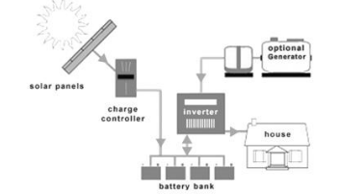
Solar Off Grid System
Independence from the utility grid
• Not subject to the terms/policies of the utility company • Rate increases, blackouts, or brownouts do not apply
• In remote areas, it is cost effective than extending a grid • Encourages energy efficiency
• Batteries require maintenance and has limited life
• More components means more complexity
• Batteries decrease system efficiency
• It is more expensive than a grid-direct system
• When the batteries are fully charged, potential power from the PV array is not utilized
• If the PV system fails, back-up electricity is required to run load
• Most off-grid systems use a backup generator for non-sunny days. They are expensive, noisy, dirty, and require fuel and regular maintenance

Slide 14
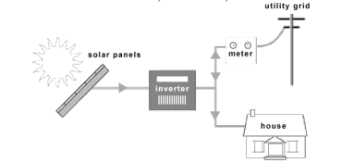
Solar Grid Tied System without Battery backup
grid-tied-system
• Increased design flexibility because the system does not have to power all of the home‘s loads
• It is less expensive compared to stand-alone or grid-tied with battery backup systems
• It requires the least amount of maintenance
• If the system produces more than the loads need, then the extra energy is exchanged with the grid
• Grid-direct systems have a higher efficiency because batteries are not part of the system
• Higher voltage means smaller wire size
• There is no power to the home when the grid goes down

Slide 15
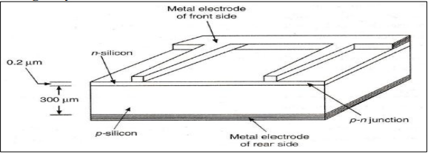
Types of Solar Cells
1. Single crystal silicon

Slide 16
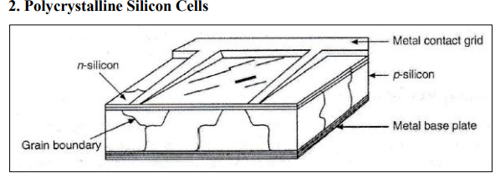
3. Amorphous Silicon Cells

Slide 17
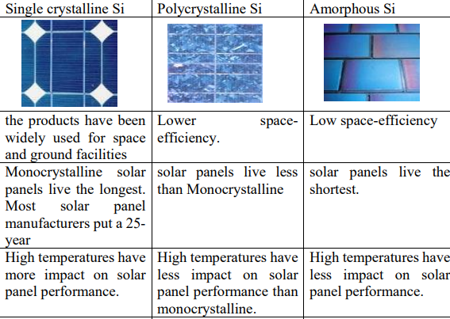



Slide 18
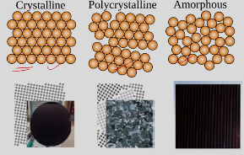

Slide 19
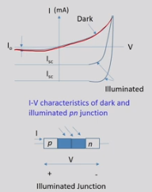

Slide 20
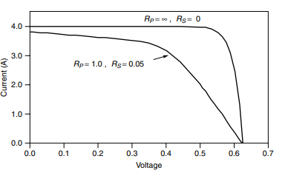
The requirements for good power production are obvious from the equivalent circuit, namely:
1 I_{ph} should be a maximum: for example through minimum photon losses, absorption near the depletion layer, a low surface reflectance, a small top surface electrical contact area, a high dopant concentration and few recombination centres.
2 i_{d} should be a minimum: for example through high dopant concentration.
3 Rsh should be large, such as by careful edge construction.
4 Rs should be small, for example by ensuring a short path for surface currents to electrical contacts, and by using low resistance contacts and leads.
5 R_{load} = R_{internal} = V/I for optimum power matching.
Figure: Series and parallel resistances in the PV equivalent circuit decrease both voltage and current delivered. To improve cell performance, high R_{p} and low R are needed

Slide 21
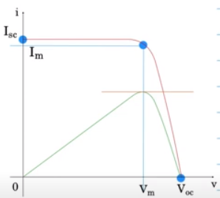

Slide 22
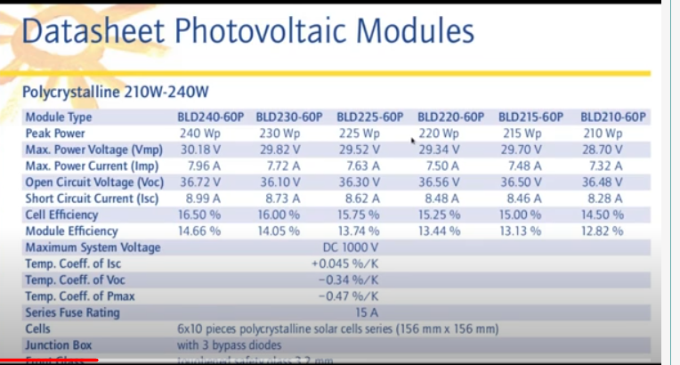

Slide 23
_{VOC} = open-circuit voltage – This is the maximum voltage that the array provides when the terminals are not connected to any load (an open circuit condition). This value is much higher than Vmp which relates to the operation of the PV array which is fixed by the load. This value depends upon the number of PV panels connected together in series.
I_{SC} = short-circuit current – The maximum current provided by the PV array when the output connectors are shorted together (a short circuit condition). This value is much higher than Imp which relates to the normal operating circuit current.
MPP = maximum power point – This relates to the point where the power supplied by the array that is connected to the load (batteries, inverters) is at its maximum value, where MPP = Imp x Vmp. The maximum power point of a photovoltaic array is measured in Watts (W) or peak Watts (Wp).
FF = fill factor – The fill factor is the relationship between the maximum power that the array can actually provide under normal operating conditions and the product of the open-circuit voltage multiplied by the short-circuit current, ( V_{OC} x I_{SC} ) This fill factor value gives an idea of the quality of the array and the closer the fill factor is to 1 (unity), the more power the array can provide. Typical values are between 0.7 and 0.8.

Slide 24
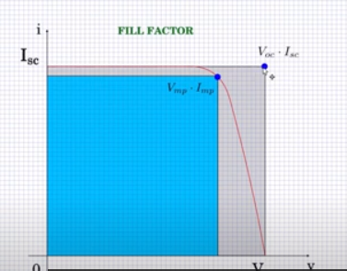
%eff = percent efficiency – The efficiency of a photovoltaic array is the ratio between the maximum electrical power that the array can produce compared to the amount of solar irradiance hitting the array. The efficiency of a typical solar array is normally low at around 10-12%, depending on the photovoltaic type (monocrystalline, polycrystalline, amorphous or thin film) of cell being used.

Slide 25
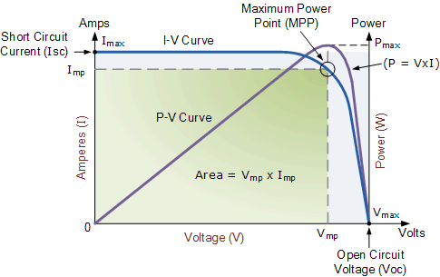

Slide 26
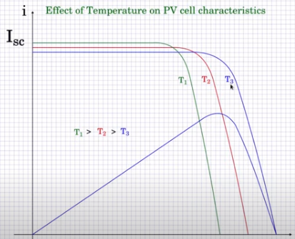

Slide 27
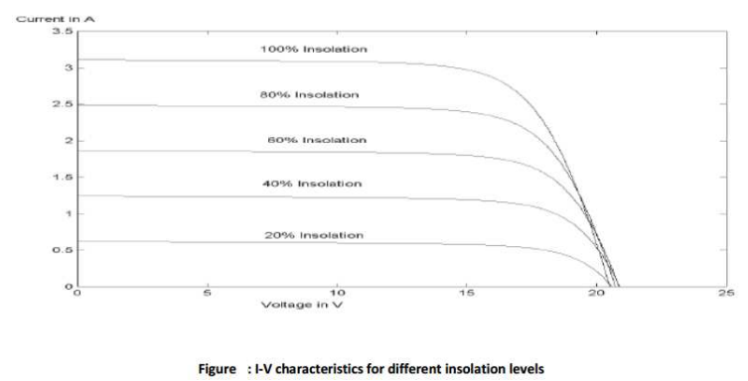

Slide 28


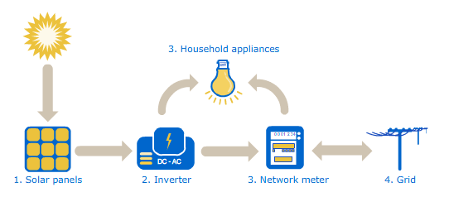

Slide 29
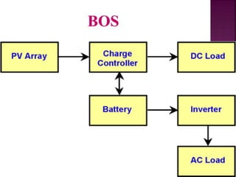

Slide 30
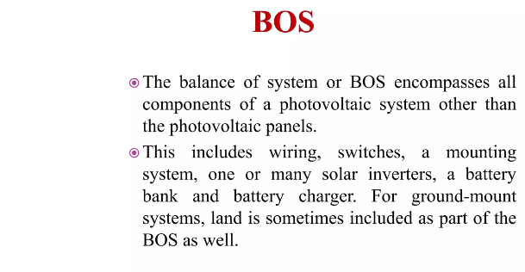

Slide 31
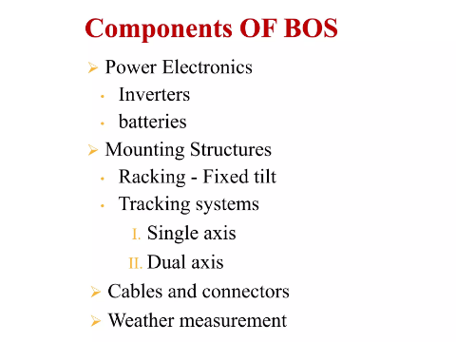

Slide 32
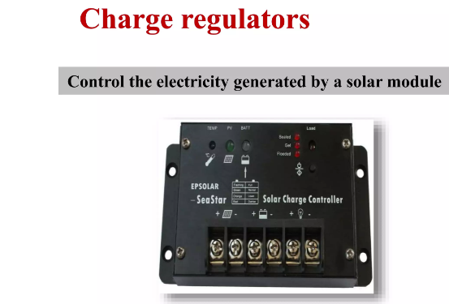

Slide 33
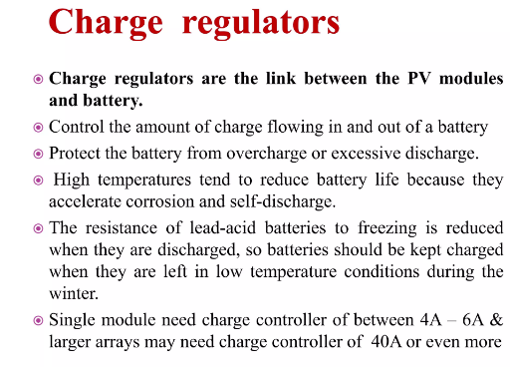

Slide 34
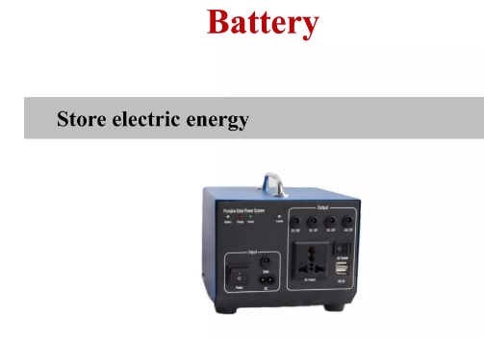

Slide 35
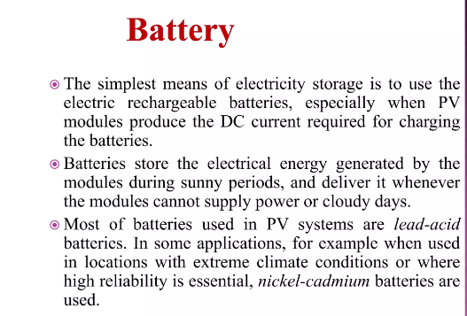

Slide 36
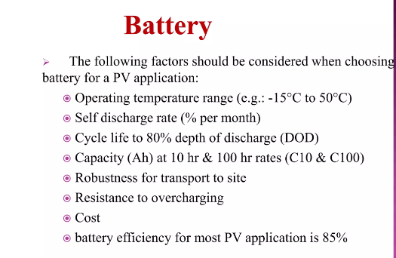

Slide 37
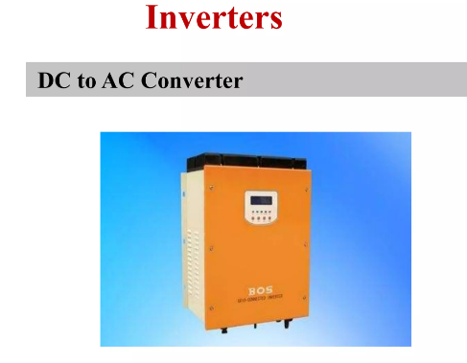

Slide 38
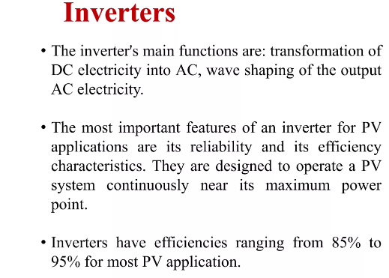

Slide 39
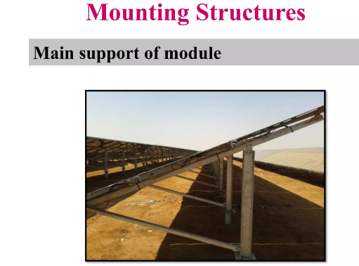

Slide 40
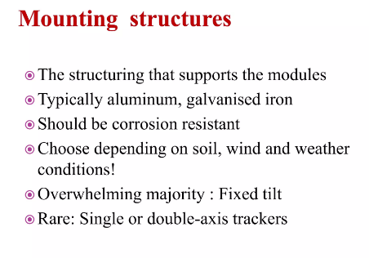

Slide 41
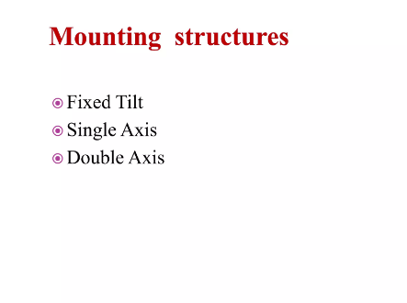

Slide 42

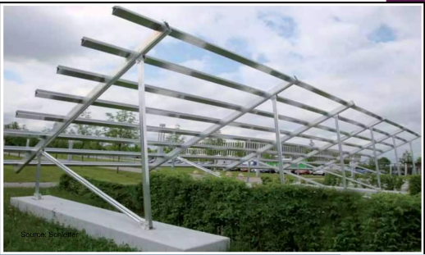

Slide 43
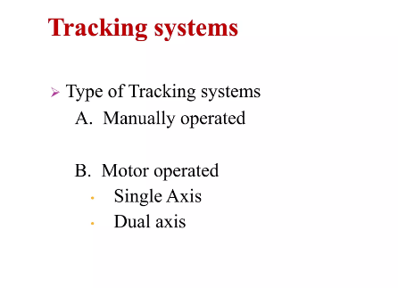

Slide 44

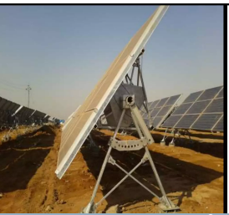

Slide 45

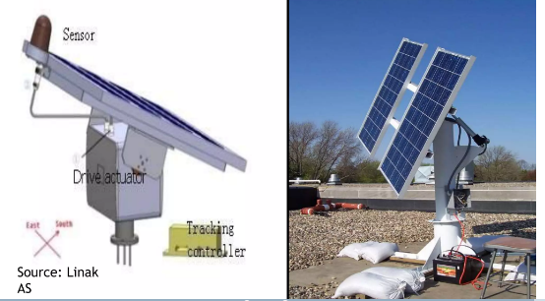

Slide 46
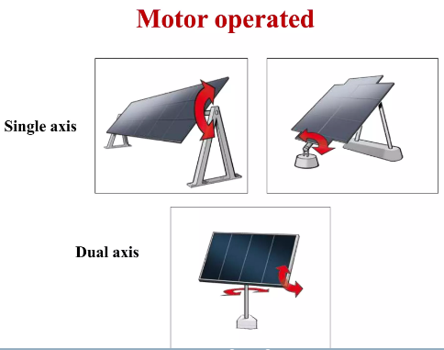

Slide 47
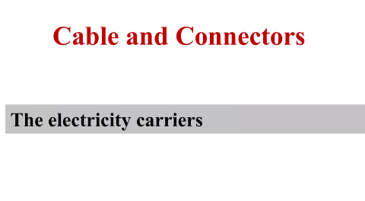

Slide 48
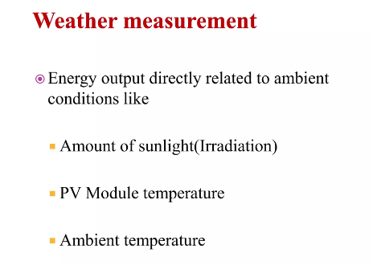

Slide 49
An Electric meter measures the amount of energy that passes through it and is commonly used by electric utility companies to measure and charge customers. For solar PV systems, a special bi-directional electric meter is used to measure both the incoming energy from the utility, and the outgoing energy from the solar PV system.

Slide 50
Applications
The increasing efficiency, lowering cost and minimal pollution are the boons of the photovoltaic systems that have led to a wide range of their application.
1.Building integrated photovoltaic systems:
The PV system is composed of a number of individual PV modules that can be connected either in series (to increase the dc output voltage up to the desired value) to form a string. Then, multiple strings are connected in parallel to increase the output current. The possibility of using multiple strings ensures the PV system modularity, which is one of the most important features of the PV technology. The arrangement of the PV modules in strings also allows for using different solutions for the dc/ac conversion.
2.Desalination plant
3. Space

Slide 51
4 . Solar home systems
5 . Pumps
6. Photovoltaic and thermal (PV/T) collector technology
7. PV/T air heating collectors

Slide 52
Solar radiation is the radiant energy emitted from the sun.
Therefore: Irradiance refers to the amount of solar radiation received per unit area by a given surface, expressed in kW/ m².
Insolation refers to the quantity of solar radiation energy received on a surface during an amount of time, expressed in kWh/ m².

Slide 53
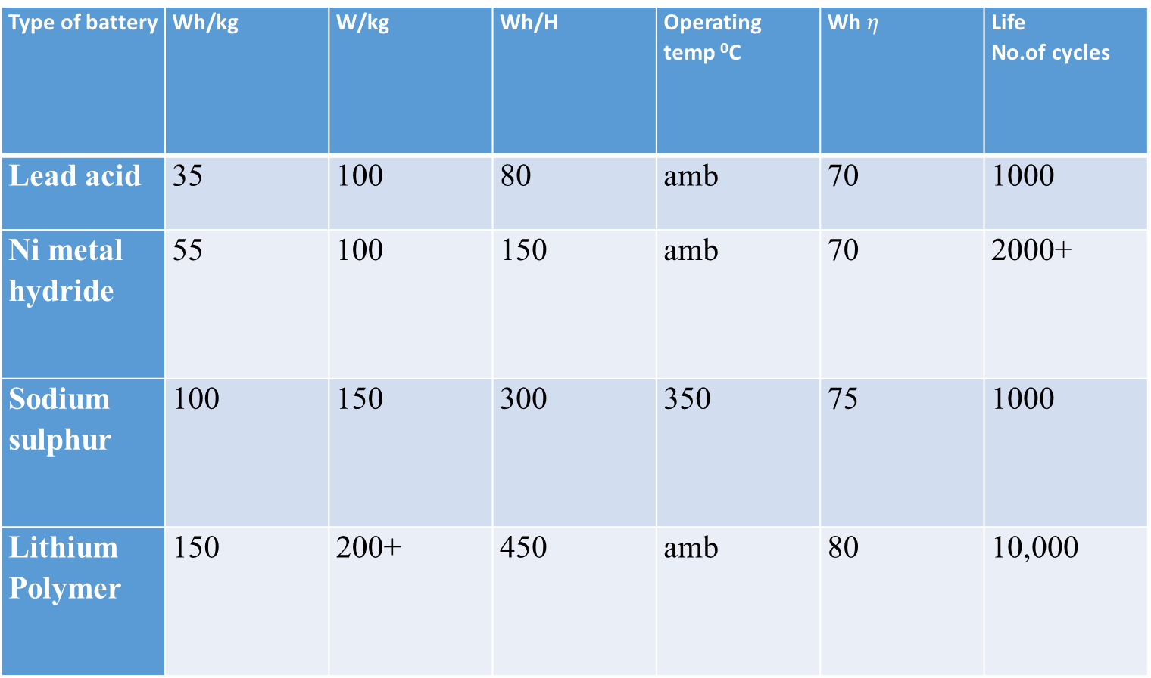
Type of battery | Wh/kg | W/kg | Wh/H | Operating temp ⁰C | Wh $η$ | Life No.of cycles
Lead acid | 35 | 100 | 80 | amb | 70 | 1000
Ni metal hydride | 55 | 100 | 150 | amb | 70 | 2000+
Sodium sulphur | 100 | 150 | 300 | 350 | 75 | 1000
Lithium Polymer | 150 | 200+ | 450 | amb | 80 | 10,000

Slide 54
1. Consider that standard insolation is incident on a 15% efficient PV panel. Calculate the intrinsic area of PV panels required if the maximum power from PV panels is 1350W.
2. For a particular application, the watt hour requirement is 500Wh. Select a battery with a nominal voltage of 12V and DoD of 50%. If the energy efficiency of the battery is 70%, then calculate the capacity of the battery.
3. Consider a 80 AH battery which has a nominal voltage of 12V. The state of charge for the battery is at 20%. If the watt-hour efficiency of the battery is 70%, then the DoD of the battery is --------------------

Slide 55
Solar PV system sizing
1. Determine power consumption demands
The first step in designing a solar PV system is to find out the total power and energy consumption of all loads that need to be supplied by the solar PV system as follows:
1.1 Calculate total Watt-hours per day for each appliance used.
Add the Watt-hours needed for all appliances together to get the total Watt-hours per day which must be delivered to the appliances.
1.2 Calculate total Watt-hours per day needed from the PV modules.
Multiply the total appliances Watt-hours per day times 1.3 (the energy lost in the system) to get the total Watt-hours per day which must be provided by the panels.

Slide 56
2. Size the PV modules
Different size of PV modules will produce different amount of power. To find out the sizing of PV module, the total peak watt produced needs. The peak watt (Wp) produced depends on size of the PV module and climate of site location. We have to consider panel generation factor which is different in each site location. For Thailand, the panel generation factor is 3.43. To determine the sizing of PV modules, calculate as follows:
2.1 Calculate the total Watt-peak rating needed for PV modules
Divide the total Watt-hours per day needed from the PV modules (from item 1.2) by 3.43 to get
the total Watt-peak rating needed for the PV panels needed to operate the appliances.
2.2 Calculate the number of PV panels for the system
Divide the answer obtained in item 2.1 by the rated output Watt-peak of the PV modules available.
Result of the calculation is the minimum number of PV panels. If more PV modules are installed, the system will perform better and battery life will be improved. If fewer PV modules are used, the system may not work at all during cloudy periods and battery life will be shortened.

Slide 57
3. Inverter sizing
An inverter is used in the system where AC power output is needed. The input rating of the inverter should never be lower than the total watt of appliances. The inverter must have the same nominal voltage as the battery.
For stand-alone systems, the inverter must be large enough to handle the total amount of Watts you will be using at one time. The inverter size should be 25-30% bigger than total Watts of appliances. In case of appliance type is motor or compressor then inverter size should be minimum 3 times the capacity of those appliances and must be added to the inverter capacity to handle surge current during starting.
For grid tie systems or grid connected systems, the input rating of the inverter should be same as PV array rating to allow for safe and efficient operation.

Slide 58
4. Battery sizing
The battery type recommended for using in solar PV system is deep cycle battery. Deep cycle battery is specifically designed for to be discharged to low energy level and rapid recharged or cycle charged and discharged day after day for years. The battery should be large enough to store sufficient energy to operate the appliances at night and cloudy days. To find out the size of battery, calculate as follows:
4.1 Calculate total Watt-hours per day used by appliances.
4.2 Divide the total Watt-hours per day used by 0.85 for battery loss.
4.3 Divide the answer obtained in item 4.2 by 0.6 for depth of discharge.
4.4 Divide the answer obtained in item 4.3 by the nominal battery voltage.
4.5 Multiply the answer obtained in item 4.4 with days of autonomy (the number of days that you
need the system to operate when there is no power produced by PV panels) to get the required
Ampere-hour capacity of deep-cycle battery.
Battery Capacity (Ah) = Total Watt-hours per day used by appliances x Days of autonomy
(0.85 x 0.6 x nominal battery voltage)

Slide 59
. Solar charge controller sizing
The solar charge controller is typically rated against Amperage and Voltage capacities. Select the solar charge controller to match the voltage of PV array and batteries and then identify which type of solar charge controller is right for the application. Make sure that solar charge controller has enough capacity to handle the current from PV array.
For the series charge controller type, the sizing of controller depends on the total PV input current which is delivered to the controller and also depends on PV panel configuration (series or parallel configuration).
According to standard practice, the sizing of solar charge controller is to take the short circuit current (Isc) of the PV array, and multiply it by 1.3
Solar charge controller rating = Total short circuit current of PV array x 1.3
Remark: For MPPT charge controller sizing will be different.

Slide 60
Example: A house has the following electrical appliance usage:
One 18 Watt fluorescent lamp with electronic ballast used 4 hours per day.
One 60 Watt fan used for 2 hours per day.
One 75 Watt refrigerator that runs 24 hours per day with compressor run 12 hours and off 12 hours.
The system will be powered by 12 Vdc, 110 Wp PV module.

Slide 61
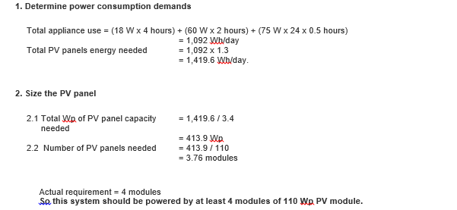

Slide 62
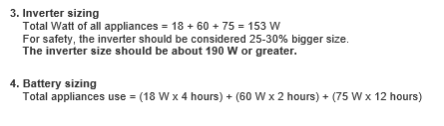
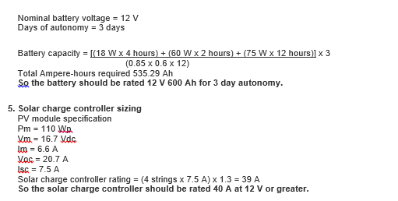

Slide 63
1. The efficiency of solar cell is about
a) 25% b)15% c) 40% d) 60%

Slide 64
2. The single solar cell voltage is about _______
a) 0.2V b) 0.5V c) 1V d)2V

Slide 65
3. What is the smallest unit of solar photo voltaic system?
a) solar cell b)solar module c)solar panel d) solar array

Slide 66
4. Which of the following is not an equipment in solar photovoltaic system?
a) Battery b)inverter c)MPPT d) Transformer

Slide 67
5. Fill factor of solar cell is always
a) less than 1 b) greater than 1 c) equal to 1 d)any of the above

Slide 68
6. A solar cell is a ---------------------
a) p- type semiconductor b) n- type semiconductor c) p-n junction d) intrinsic semiconductor

Slide 69
7. __________ is one of the most important materials is also known as solar grade silicon.
a) Crushed silicon b) Crystalline silicon c) Powdered silicon d) Silicon

Slide 70
9. Select the wrong statement about solar cell from the following.
Solar cells have moving parts.
Maintenance is not required periodically.
c) Setup can be done at remote and hilly places.
d) Focusing devices are not necessary to concentrate the radiations.

Slide 71
A module in a solar panel refers to
series arrangement of solar cells
parallel arrangement of solar cells
c) series and parallel arrangement of solar cells
d) none of the above

Slide 72
Batteries used for electrical energy storage are----
Laclanche cell
Edison cell
Lead acid cell
any of the above

Slide 73
What does the word Photovoltaic mean?
Light-cell
Sun-powered
Light-electricity
solar-energy

Slide 74
The electrical output of solar cell depends on
(a) the intensity of solar radiation
(b) heat component of solar radiation
(c) UV component of solar radiation
(d) MIR component of solar radiation

Slide 75
Depth of discharge for Li-polymer batteries is
a)20%
b)>50%
c) 30%
d)<50%

Slide 76
As the temperature increases, the efficiency of the PV cell will
Improve
Increases
Decreases
Remain unchanged

Slide 77
Which among the following conditions lead to a PV cell having poorest fill factor? (Rs is the series resistance and Rsh is the shunt resistance in the PV model)
Rs and Rsh are low
Rs is high and Rsh is low
Rs is low and Rsh is high
Rs and Rsh are high

